Slide 1
Employee Education Session
2021 Benefits

Slide 2
Objectives
Open Enrollment
Health Fair & Flu Shot Clinic
Dental and Vision Plans
Medical Plans
  Health Savings Accounts
  Flexible Spending Accounts
Optional Supplemental Benefits
Additional Resources

Slide 3
Open enrollment

Slide 4
Open Enrollment
September 28th – October 23rd
Mandatory for all full time employees
  Medical
  Dental
  Vision
  Flexible Spending/Dependent Care Accounts
  Health Savings Accounts
On-line enrollment through payroll portal
  Ensure you can log in and access portal
Notes:
Complete at your convenience through the payroll portal
Assistance available during Health Fair/Flu shot clinics
Outside of a qualifying life event, this is the only time you can make changes to your plans and/or dependents

Slide 5


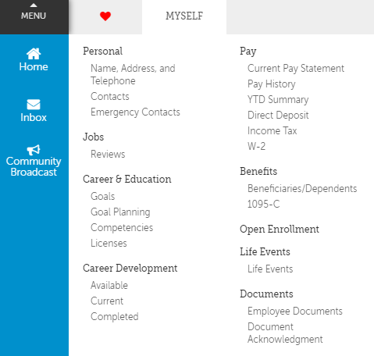
Open Enrollment – payroll portal
Notes:
Make sure you can get into payroll portal prior to OE
If you are unable to access the portal, send email to HR

Slide 6
optional oe items – NOT ON PORTAL
Supplemental Benefits
  Aflac
  Supplemental Term Life (Hartford)
  401k and 457 plans
  Pet Insurance Enrollment
Notes:
Add notes about how to access assistance
Add notes about how to make changes

Slide 7
Health Fair/Flu Shots 2021

Slide 8
Details…
Virtual Benefit Vendor Experience
Flu Shot Clinics @ Post 100
  October 12th through October15th
  3:00pm – 8:00pm each day
  Outdoor Sound Stage
Biometrics NOT OFFERED and NOT REQUIRED
Fit testing for field employees ONLY if not tested on 8511 series

Slide 9
Flu shots
SCHEDULE
  Online by 10/9/2020
  Scheduler link will be sent out as Agency email
MUST BRING:
  Medical insurance card
  MEDIC ID Badge
  PPE
REQUIRED:
  PPE
  Social distancing
Completion or declination DUE by 10/23/2020
Notes:
MUST BRING:
MEDICAL INSURANCE CARD
MEDIC ID BADGE
Located in CLASSROOMS 117A/B
Appointment must be scheduled – link will be sent out
Must wear PPE and properly distance
If unable to attend one of the clinics, you must provide verification of flu shot or declination documentation
Must be received by 10/23/2020

Slide 10
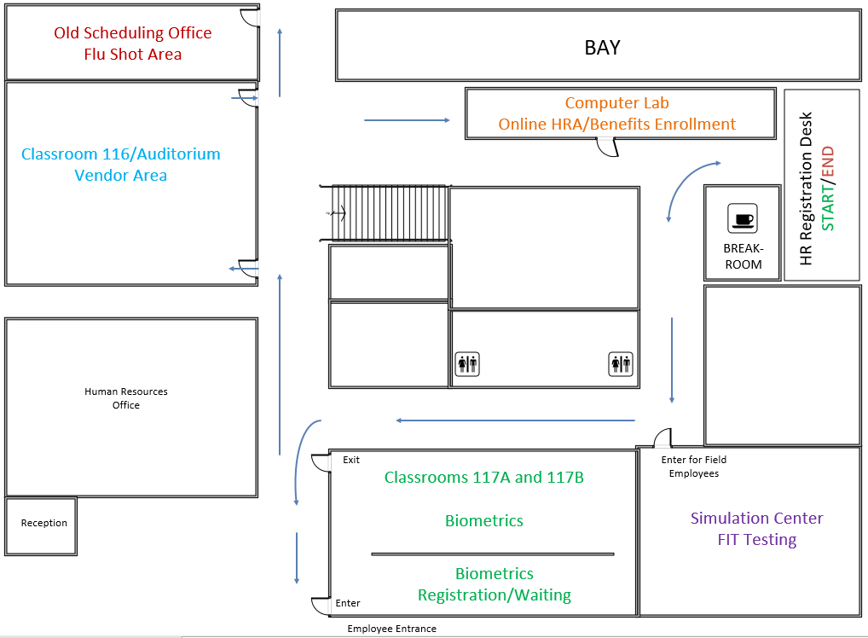
FLU SHOT CLINIC LOCATION
Exit to Parking Lot
FLU SHOT CLINIC
Front Lobby
Notes:
Add notes YOU ARE HERE

Slide 11
For discounted wellness rate 2021
Open Enrollment
On-line Health Risk Assessment (BCBS)
Flu shot
Biometrics NOT REQUIRED for discounted premiums this year
All items must be completed by 10/23/2020
Submit flu shot verification via email HumanResources@medic911.com or drop in HR Lockbox
Notes:
For discounted premiums this year
Complete open enrollment through payroll portal (full time employees)
Complete on-line Health Risk Assessment through www.bluecrossnc.com
The HRA will request biometrics information. You can leave these questions blank to complete the questionnaire.
Receive flu shot or provide declination documentation

Slide 12
Dental and vision

Slide 13
Dental and vision
Dental
  Remains with CIGNA; no ID card
  Small increase to premiums
  No changes in plans or coverage
Vision
  Remains with United HealthCare; no ID card
  No changes in premiums
  No changes in plans or coverage
Notes:
Standard and Enhanced options offered for both plans

Slide 14
Dental rates
2020 Dental Rates
Semi-monthly - 24 Pay Periods | Employee Only | Employee+ Child(ren) | Employee + Spouse | Family
Standard Plan | $2.39 | $15.45 | $12.56 | $24.70
Enhanced Plan | $3.93 | $25.38 | $20.63 | $40.57
2021 Dental Rates
Semi-monthly - 24 Pay Periods | Employee Only | Employee+ Child(ren) | Employee + Spouse | Family
Standard Plan | $3.26 | $17.26 | $14.16 | $27.18
Enhanced Plan | $5.36 | $28.37 | $23.27 | $44.67

Slide 15
Medical and prescription

Slide 16
What’s staying the same with medical
Plan Options and Eligibility
  Benefit eligible employees hired before January 1, 2017, may enroll in either:
    PPO plan
    High Deductible plan
  Benefit eligible employees hired/rehired on or after January 1, 2017, may only enroll in:
    High Deductible plan

Slide 17
What’s changing for 2021
Medical Premiums are DECREASING
Medical & Prescription Plan Changes
  Out-of-pocket max increase for both plans
  Co-insurance increase for both plans
  Drug tier cost increase
  Dispense-as-written prescriptions
Specific Plan Changes
  PPO
    Increase to Urgent Care co-pay
  HDHP
    Seed account funding decrease

Slide 18

Medical Rates
2020 Medical Rates
Semi-monthly - 24 Pay Periods | Employee Only | Employee+ Child(ren) | Employee + Spouse | Family
PPO Wellness | $63.14 | $143.10 | $185.19 | $294.63
HDHP Wellness | $41.33 | $105.39 | $136.39 | $216.99
PPO Non-Wellness | $88.14 | $168.10 | $210.19 | $319.63
HDHP Non-Wellness | $66.33 | $130.39 | $161.39 | $241.99
2021 Medical Rates
*savings of additional $400 annually with wellness initiatives
Semi-monthly - 24 Pay Periods | Employee Only | Employee+ Child(ren) | Employee + Spouse | Family
PPO Wellness | $46.47 | $126.44 | $168.53 | $277.96
HDHP Wellness | $24.67 | $88.73 | $119.73 | $200.32
PPO Non-Wellness | $88.14 | $168.10 | $210.19 | $319.63
HDHP Non-Wellness | $66.33 | $130.39 | $161.39 | $241.99

Slide 19
Plan Changes comparison
Benefit | PPO 2020 | PPO 2021 - Changes | HDHP 2020 | HDHP 2021 - Changes
Out of Pocket - Ind / Family | $3,600 / $10,800 | $5000 / $10,000 | $3,550 / $7,100 | $5000 / $10,000
Co-Insurance | 20%, after deduct | 25% after deduct | 20%, after deduct | 25% after deduct
Emergency Room | 20%, $225 copay | 25% $225 copay | 20%, after deduct | 25% after deduct
Urgent Care | $25 copay | $60 copay | 20%, after deduct | 25% after deduct
Prescription Tier 1 | $10 copay | $15 copay | 20%, after deduct | 25% after deduct
Prescription Tier 2 | 20% $25 min/$75 max | 25% $30 min/$90 max | 20%, after deduct | 25% after deduct
Prescription Tier 3 | 40% $50 min/$100 max | 40% $60 min/$120 max | 20%, after deduct | 25% after deduct
Mail Order Script Tier 1 | $20 copay | $30 copay | 20%, after deduct | 25% after deduct
Mail Order Script Tier 2 | 20% $50 min/$150 max | 25% $60 min/$180 max | 20%, after deduct | 25% after deduct
Mail Order Script Tier 3 | 40% $100 min/$200 max | 40% $120 min/$240 max | 20%, after deduct | 25% after deduct

Slide 20
PPO Rates & Coverages for 2021
Semi-monthly - 24 Pay Periods | Employee Only | Employee+ Child(ren) | Employee + Spouse | Family
Discounted Wellness Rate | $46.47 | $126.44 | $168.53 | $277.96
Non Discounted Rate | $88.14 | $168.10 | $210.19 | $319.63
PPO Plan – full time benefit eligible employees hired as of 01/01/2017 (no breaks in service)
In-Network Deductible (Single/Family) | $600/$1,200
Out-of-Network Deductible (Single/Family) | $1,500/$3,000
In-Network Co-insurance | 25%
Out-of-Network Co-insurance | 40%
In-Network Out of Pocket Max (includes deductible) | $5,000/$10,000
Out-of-Network Out of Pocket Max (includes deductible) | $10,800/$21,600
Office Visits (PCP/Specialist) | $25/$40 copay
Emergency Room | $225 copay, then 25% (no deductible)
Urgent Care | $60 copay
Preventative Generics | 100% Covered
Retail Generic | $15 copay
Retail Preferred Brand | 25% $30 minimum, $90 maximum
Retail Non-Preferred Brand | 40% $60 minimum, $120 maximum
Notes:
PPO has copays, deductible and co-insurance
No vision provision

Slide 21
Q-HDHP Rates and coverage for 2020
Semi-monthly 24 Pay Periods | Employee Only | Employee+ Child(ren) | Employee + Spouse | Family
Discounted Wellness Rate | $24.67 | $88.73 | $119.73 | $200.32
Non Discounted Rate | $66.33 | $130.39 | $161.39 | $241.99
High Deductible Plan – full-time benefit eligible employees
In-Network Deductible (Single/Family) | $1,600/$3,200
Out-of-Network Deductible (Single/Family) | $3,200/$6,400
In-Network Co-insurance | 25%
Out-of-Network Co-insurance | 40%
In-Network Out of Pocket Max (includes deductible) | $5,000/$10,000
Out-of-Network Out of Pocket Max (includes deductible) | $7,100/$14,200
All other services | 25% after deductible
Preventative Generic | 100% covered
Retail Generic | 25% after deductible
Retail Preferred Brand | 25% after deductible
Retail Non-Preferred Band | 25% after deductible
Notes:
HDHP with deductibles and co-insurance
Benefits brochure can be used to compare the medical insurance plans

Slide 22
Prescriptions – CVS health
Tier Levels
    Generic preventatives= generics and most preventative generic
    Tier 1 = most retail generics
    Tier 2 = retail preferred brand
    Tier 3 = retail non-preferred brand
Tier 1 covers medications at 100% of the cost if classified as preventative.
Prescriptions must be ‘Dispensed As Written’ (DAW) to avoid difference in cost

Slide 23
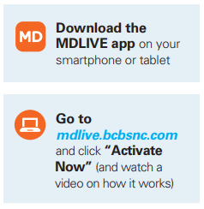
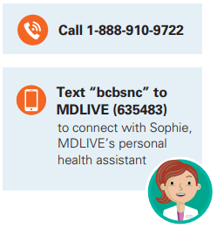

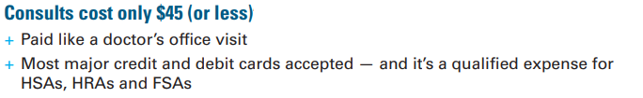
Telehealth
24/7 access to a physician without leaving home!
Four ways to activate
Notes:
Reminder that this is available resource to use

Slide 24
HsA and flex savings

Slide 25
Health Savings Account (HSA)
HSA Bank is Health Equity
Paired with Q-High Deductible Health Plan
Pre-tax payroll deductions
Debit card
Balance rolls over each year
Portable

Slide 26
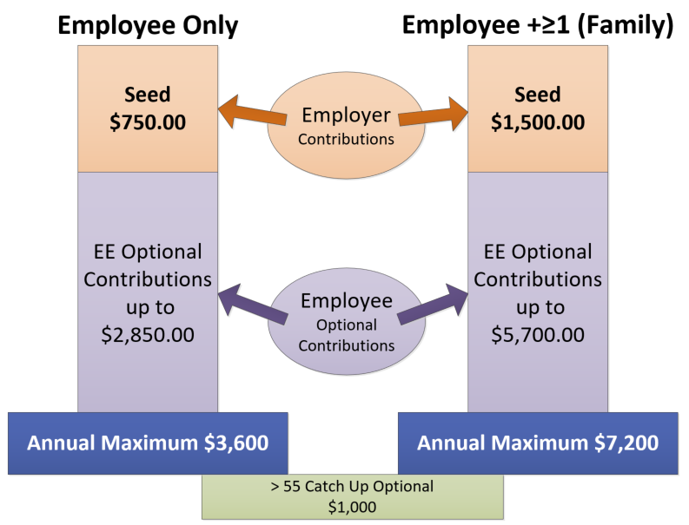

Slide 27
Traditional FSA
Paired with PPO only
Pre-tax payroll deductions, up to $2,750.00
Debit card
Plan allows funds to be used through March 15, 2022
May use funds at www.fsastore.com in addition to in-person use
Notes:
Important Note: If you currently have a traditional FSA and enroll into the High Deductible for 2021, you MUST use all funds by December 31, 2020

Slide 28
Limited Purpose FSA
Paired with Q-HDHP only
Pre-tax payroll deductions, up to $2,750.00
Debit card
Vision and Dental claims/expenses only
Plan allows funds to be used through March 15, 2022
May use funds at www.fsastore.com in addition to in-person use

Slide 29
Dependent Care Accounts
All full-time employees eligible for this plan
Pre-tax payroll deductions, up to $5,000.00
Used to pay for eligible dependent care services such as daycare, summer day camp, before or after school programs, etc.
Must have funds from your pre-tax payroll deductions in the account to use for expenses

Slide 30




What savings plans go with…
PPO Plan
High Deductible
Both Plans
FSA
HSA
Dependent Care
LPFSA
Dental
Vision
*You must re-elect these accounts each year.
Notes:
DCA is pre-tax deduction to use for child care

Slide 31
Dependent verification
Reminder!
  AON Hewitt (Alight Solutions) is 3rd party vendor
  If enrolling a new dependent, you will be asked to verify eligibility
  Dependent documentation can be uploaded, faxed or mailed
For OE and qualifying events
  When adding dependents to medical, dental or vision plans provide supporting documentation to HR
  For qualifying events, you must enroll or remove dependents within 31 days of the event
Notes:
Qualifying event = 31 days from date of event

Slide 32

Additional Resources
Flu Shot Clinics:
  October 12th – October 15th
  3PM – 8PM each day
2021 Benefit Brochures
  Online through Extranet “Health Fair & Benefit Info”
  Time Clocks
  HR Team
    10/12 – 10/15, 8AM – 8PM

Slide 33
Questions?
Contact the HR Department at HumanResources@medic911.com

